Slide 1
Option 3: Store Sales Forecasting
ECON 5140 – Class Presentation
February 26, 2026

Slide 2
Project overview
Objective: Produce a 30-day ahead forecast of total sales across a network of retail outlets using multiple forecast methods
Data:
Daily time series data
54 stores of five types (A, B, C, D, E)
33 product families (e.g., Beverages, Pet Supplies)
Limited promotions data: count of items on promotion each day
January 2013 to August 2017

Slide 3
Project methodology and model implementation followed a five-step process
Data structure
Data visualization and repair of long-blocks of missing data
Decomposition through additive regression model
Forecast modeling using ETS, ARIMA, and Prophet
Evaluation of model performance (MAE, RMSE, MAPE and PACF)

Slide 4
1. Data Structure
Daily time index
Date range: 2013-01-01 to 2017-08-15
Missing only four dates – Christmas Day for 2013, 2014, 2015, 2016. These dates will simply be ignored in the models.
100% of records complete and consistent. All 54 stores and all 33 product families report sales each day (even if zero).
During the sample period, initial sales occur in 46 stores and then over time 8 new stores appear to open and then add to the total sales data

Slide 5
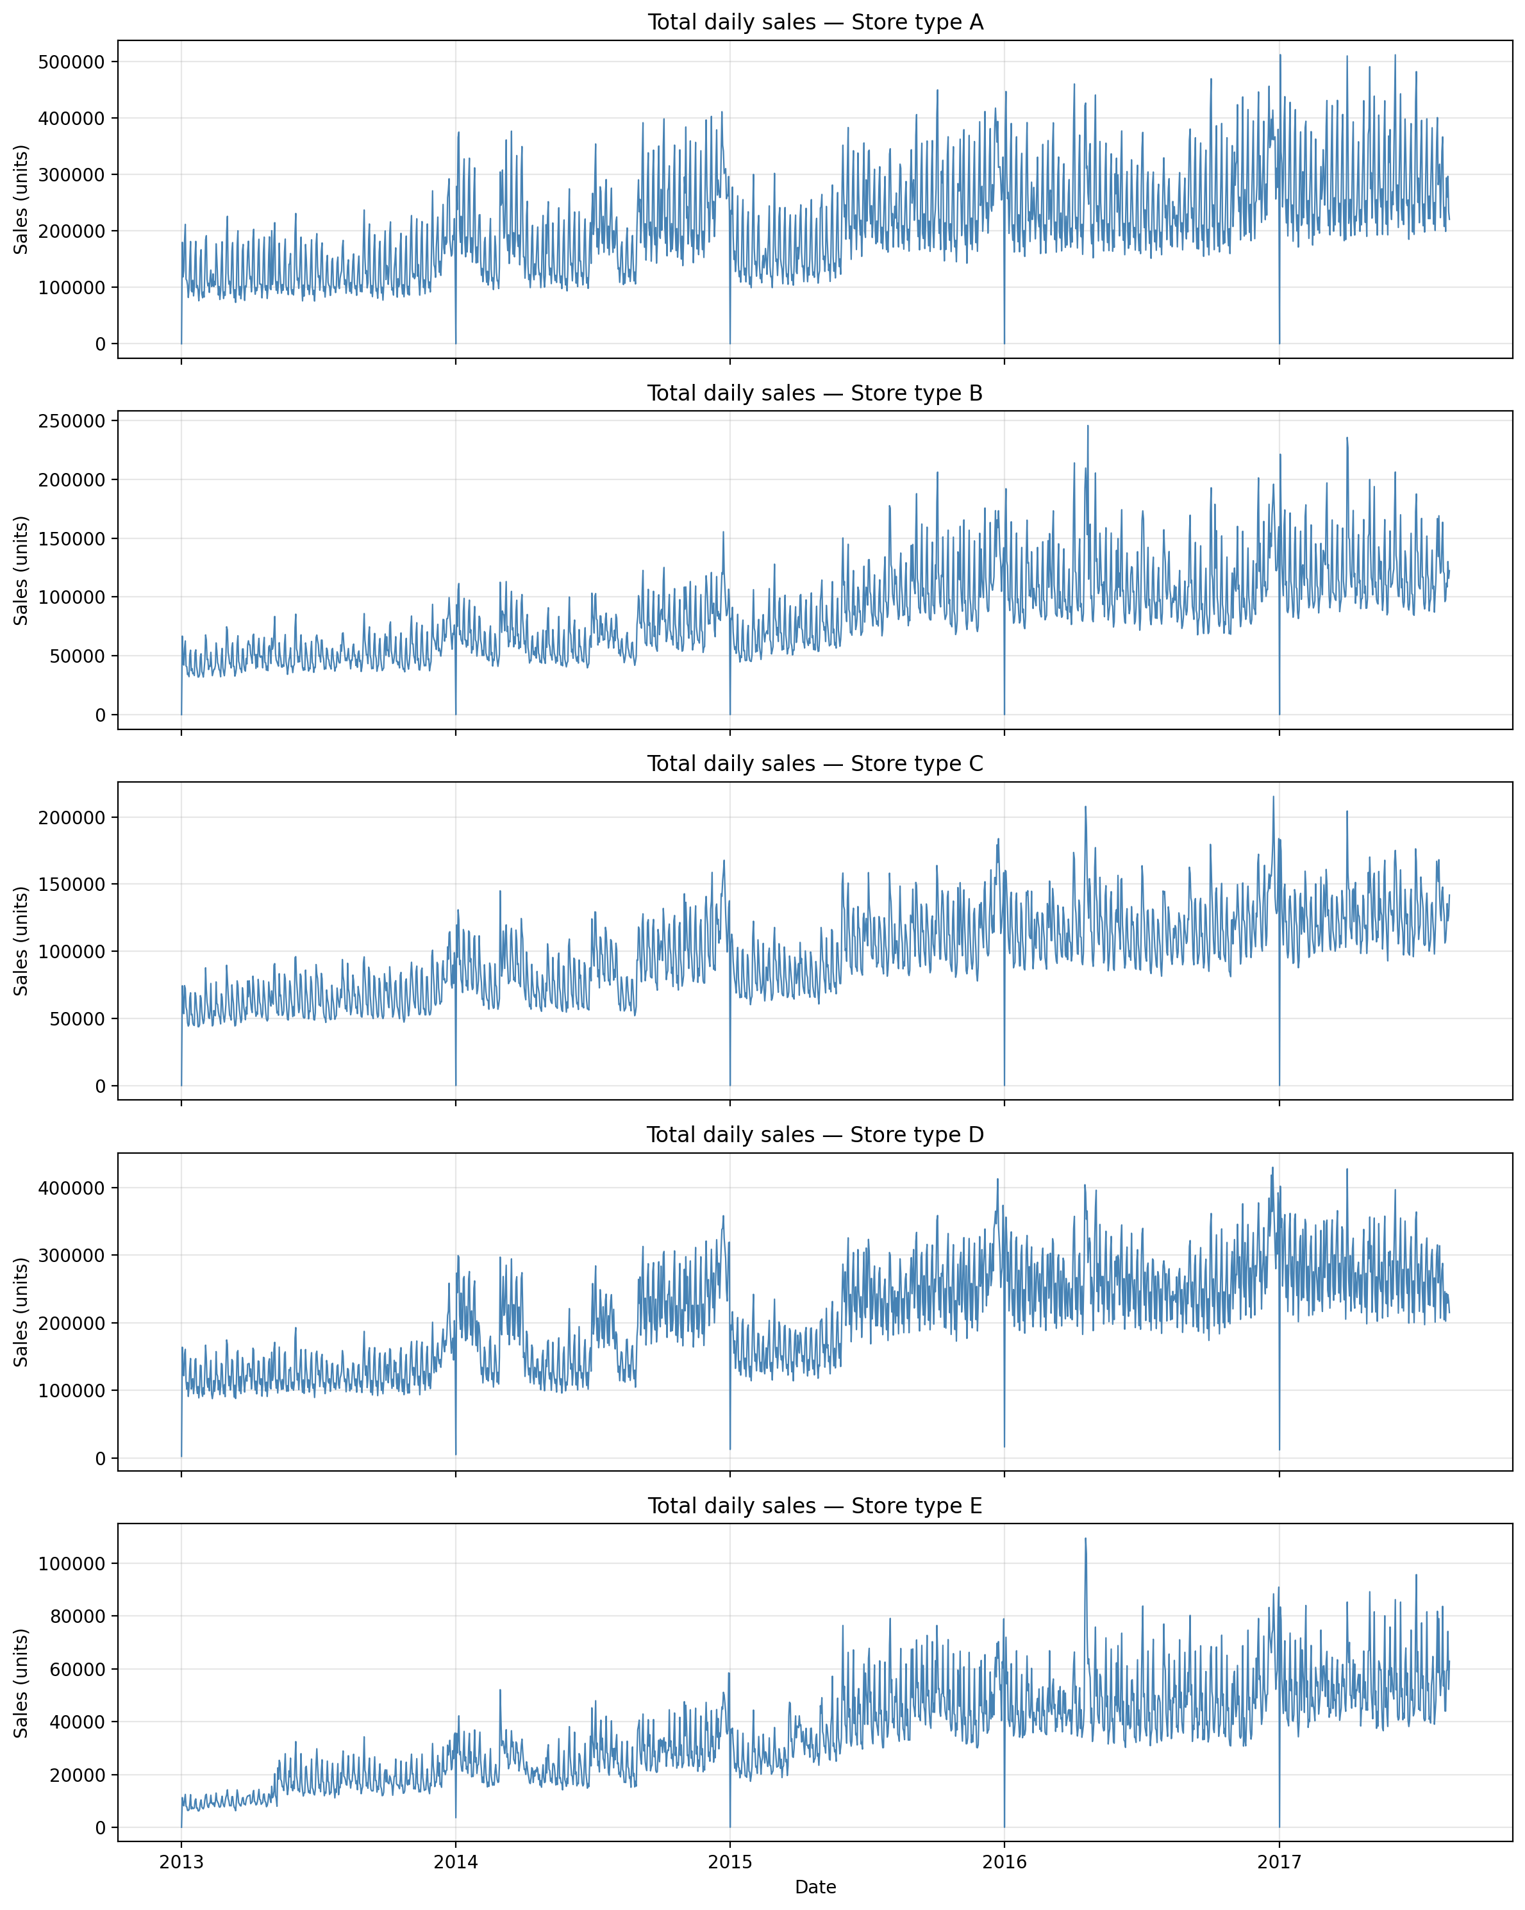
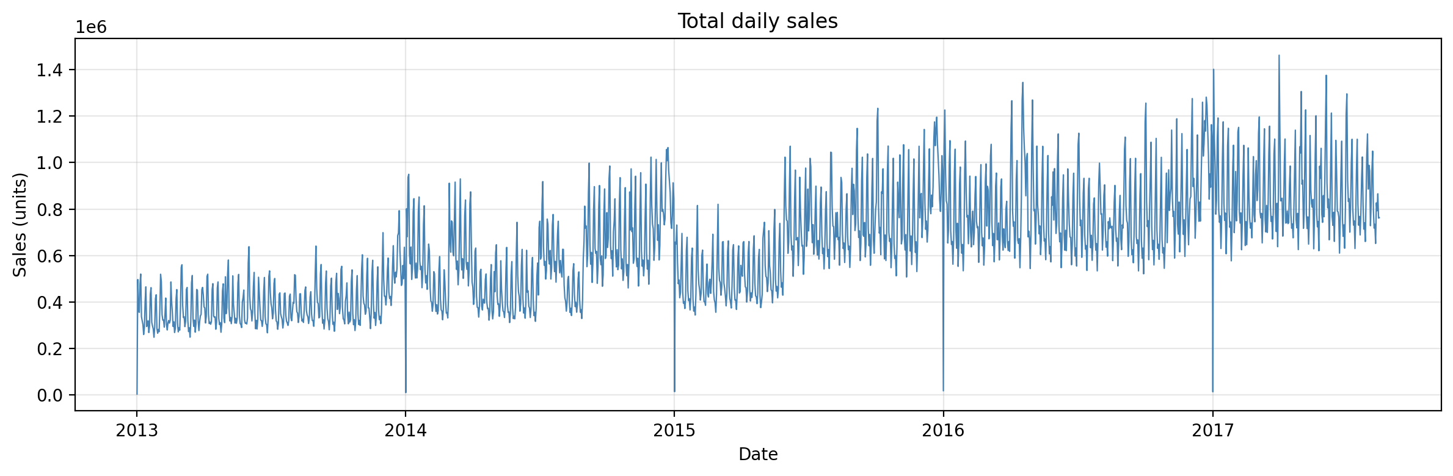
2. Data Visualization revealed a non-stationary series with an upward trend and increasing variance … and a similar pattern across store types

Slide 6
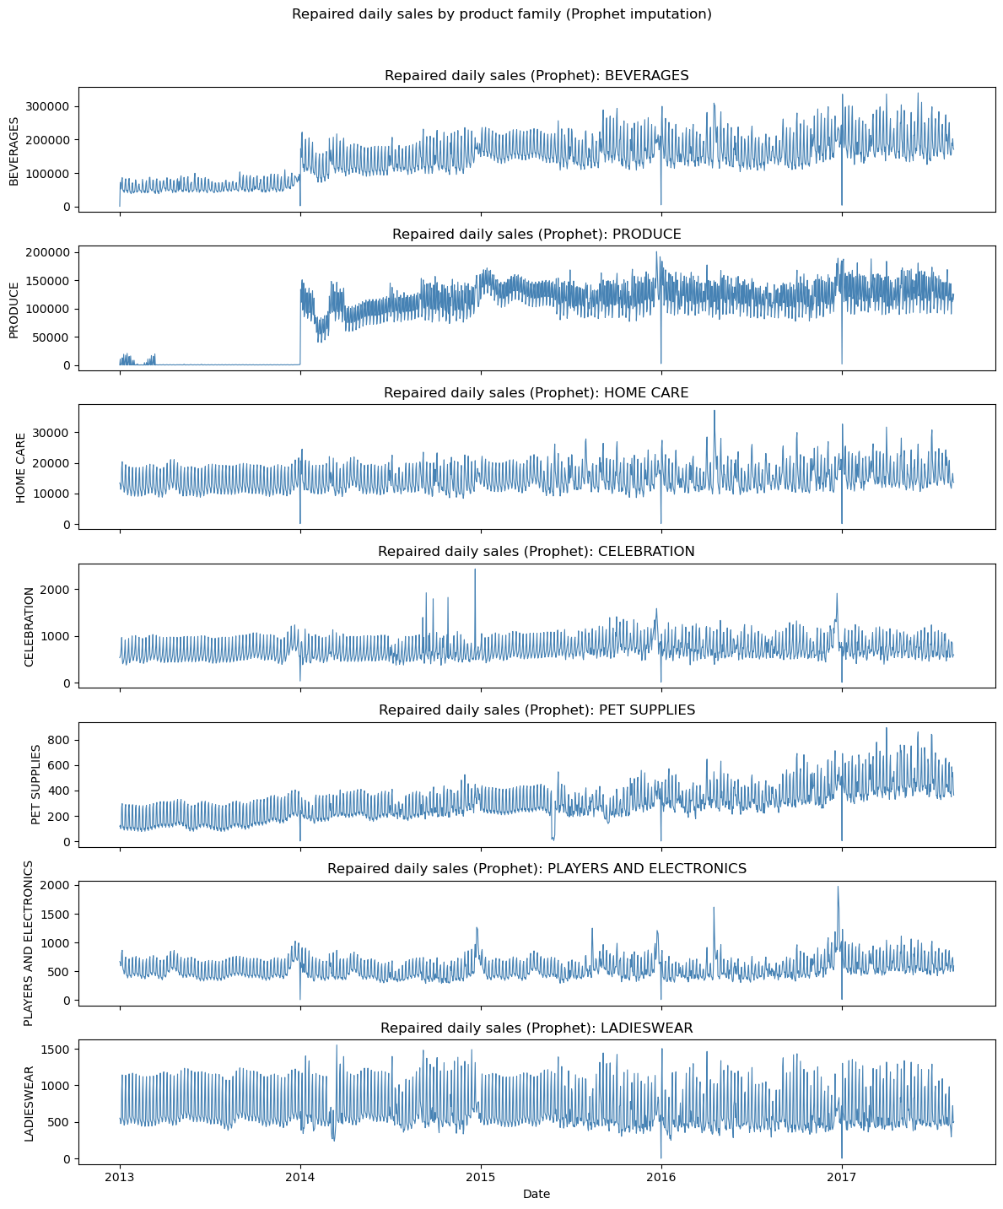
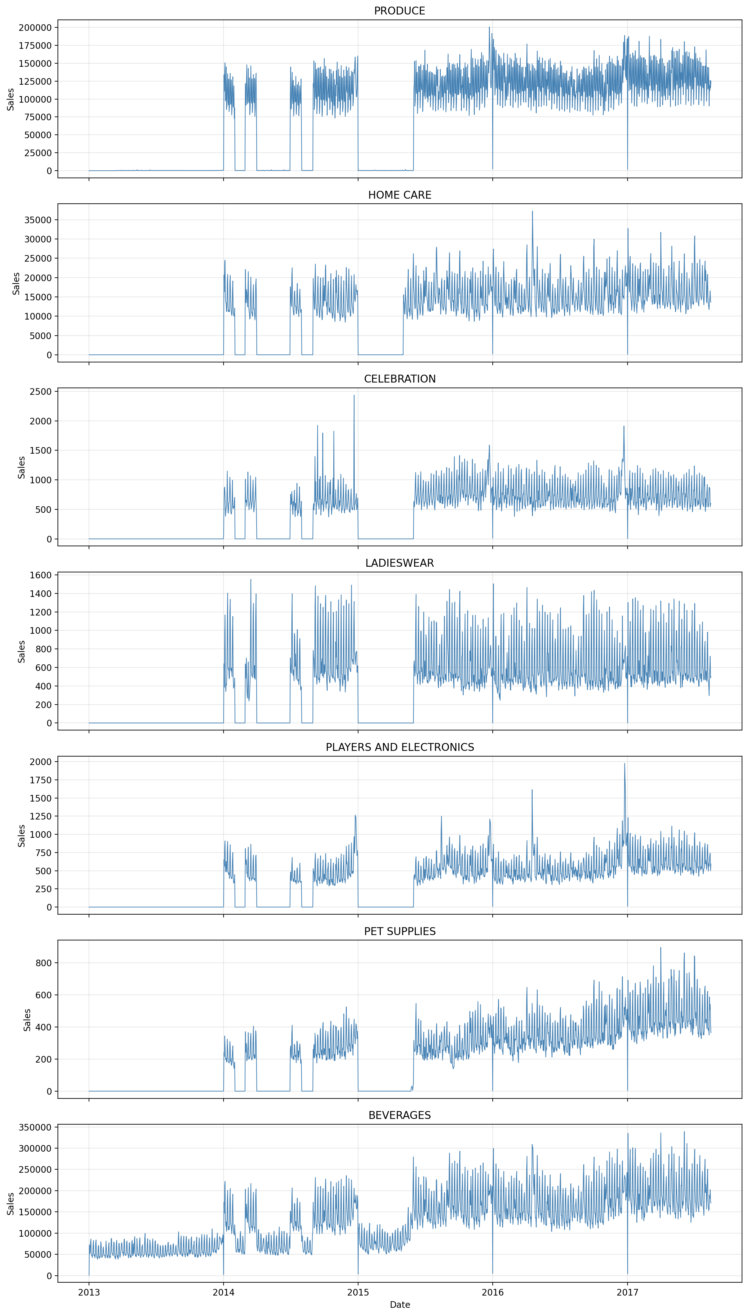
2. Data Repair: a Prophet model to interpolate for long periods of missing data
For the purposes of this exercise, we assume that prolonged periods of zero sales for certain product families is due to missing data – in practice, this would have to be verified.
Multiple product families have the same data gaps, which further suggests a data problem.

Slide 7
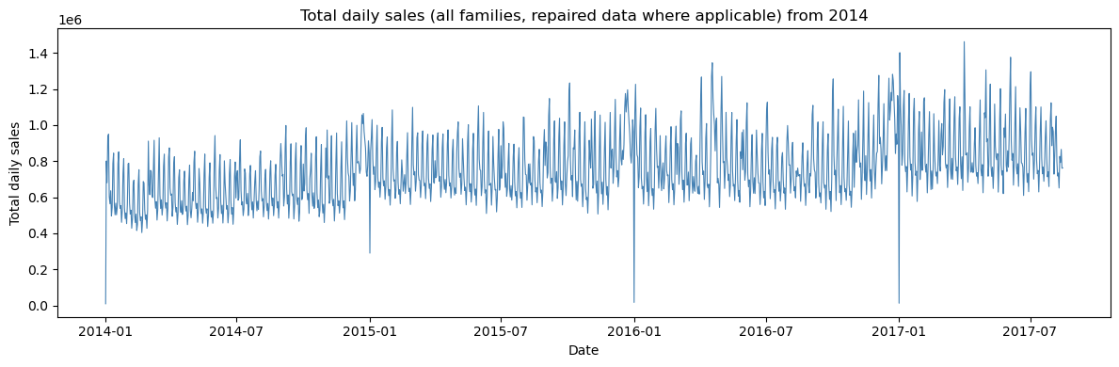
2. Once repaired, the series is much smoother
Made the modeling decision to remove 2013 in the repaired data set because of a level change in two large product families: DAIRY and POULTRY

Slide 8
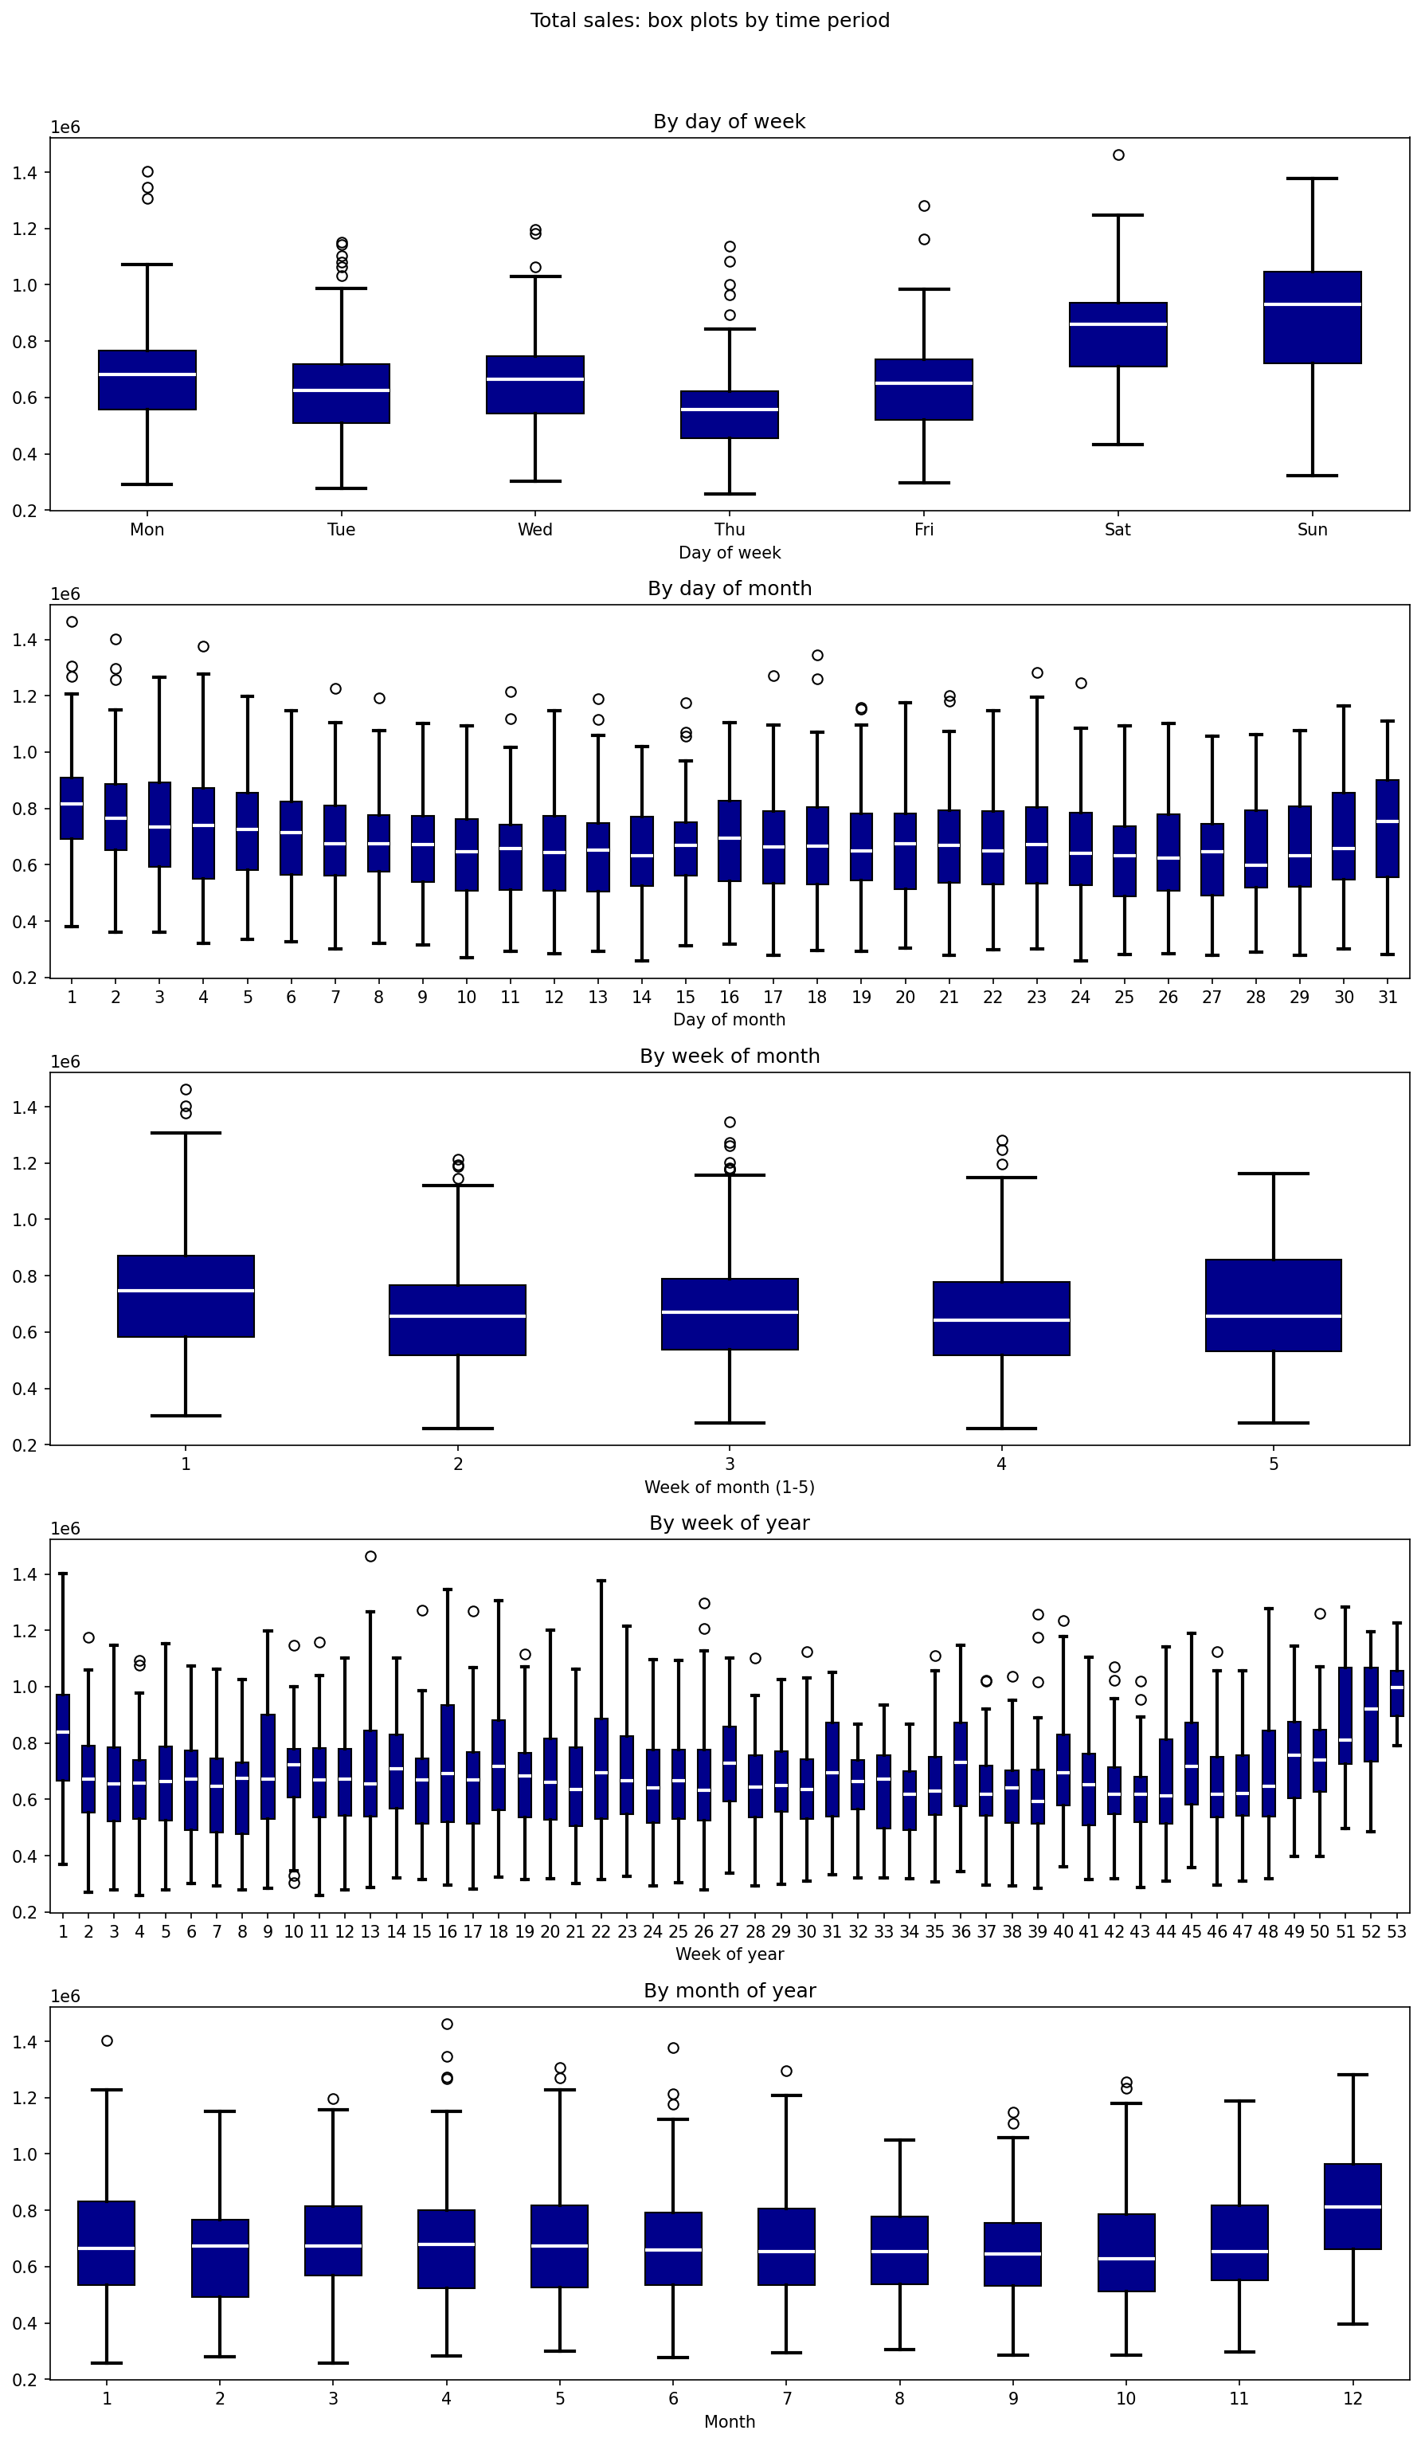
2. Data Visualizations – multiple seasonal patterns revealed by the box plots
Sunday is the peak day. Thursday is the trough day.
Pay-day effect (day of month).
Christmas seasonal effect, higher for certain products (Frozen Foods, Grocery, Home and Kitchen I)
Product specifics:
Sales for Liquor, Wine, Beer spike at New Years; no sales Sundays until 2016
All but one store is closed on New Year’s Day. Other holidays do not cause store closure.
School and Office Supplies have seasonal jumps
Home Appliances, Baby Care, and Books have odd patterns but are the smallest families

Slide 9
Step 3. Modeling
ETS
Prophet
OLS Regression decomposition with ARIMA … and also ETS, and Prophet
Notes:
Removed outliers of January 1st each year
Train data starts in 2014 due to level increase in DAIRY AND POULTY at end of 2013

Slide 10
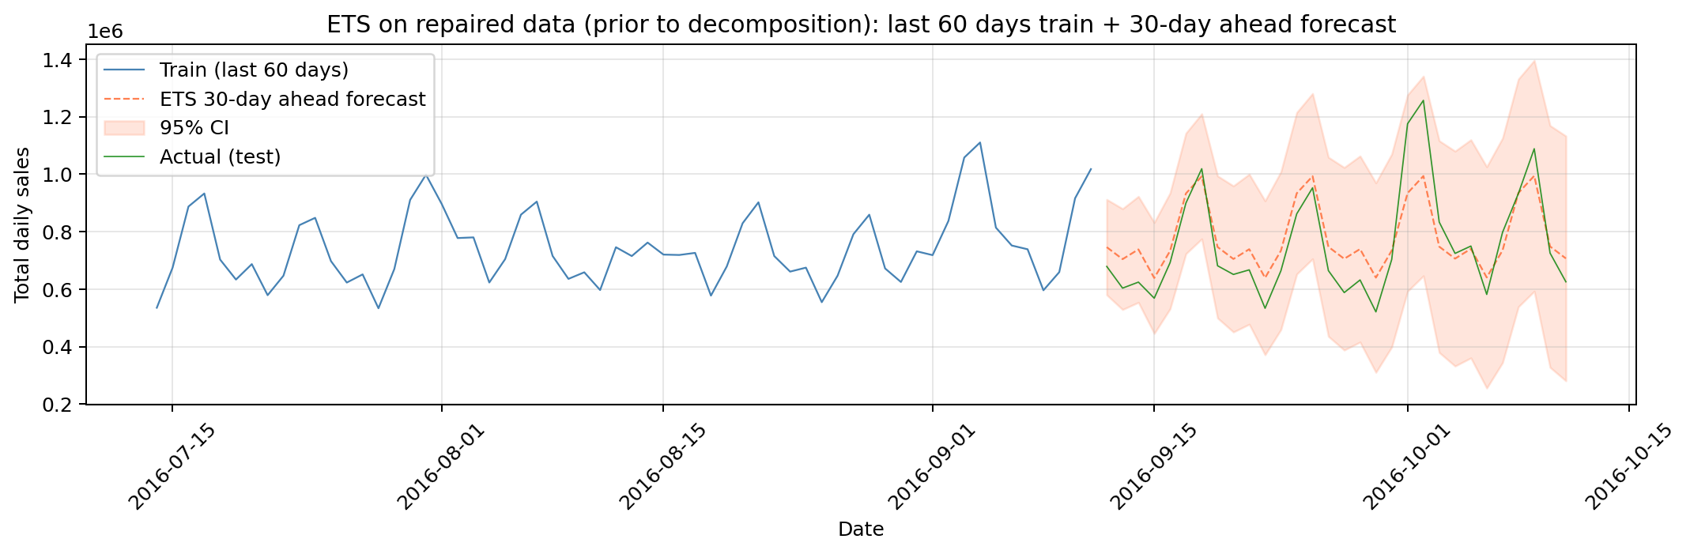
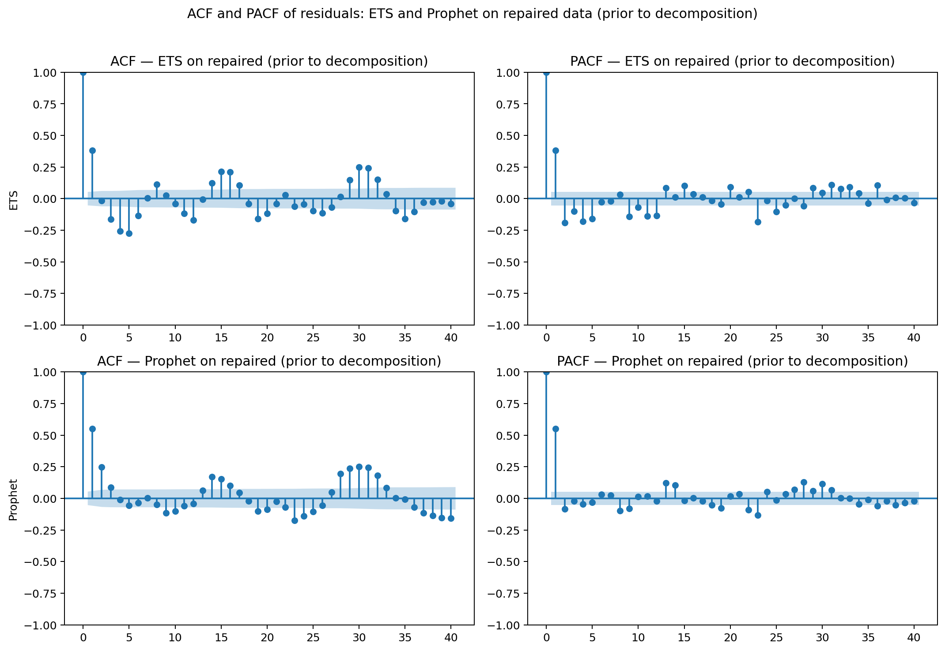
3A. ETS model; 80/20 train-test (decomposition in model)
Holt-Winters or ETS(A,A,A): Additive errors, Additive Trend, Additive Seasonality - Performance
MAE | 77637
RMSE | 96119
MAPE | 10.4%

Slide 11
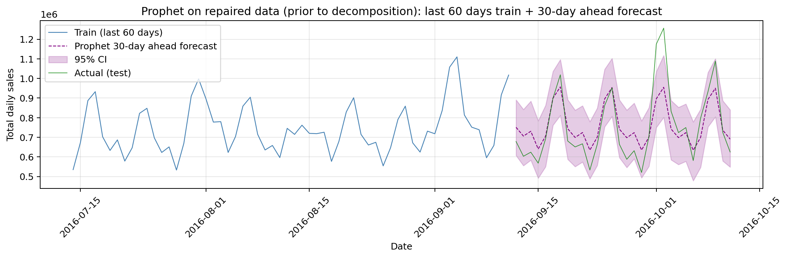
3B. Prophet with 80/20 train-test (decomposition in model)
Prophet Model Visualization and Performance
MAE | 88997
RMSE | 118626
MAPE | 9.2%

Slide 12
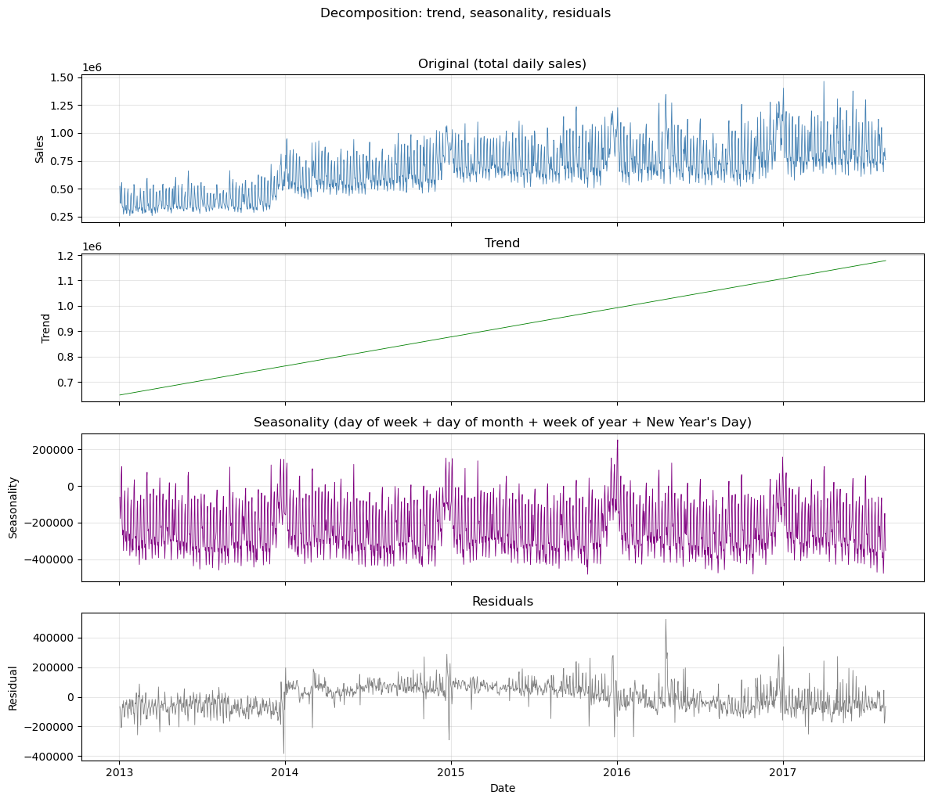
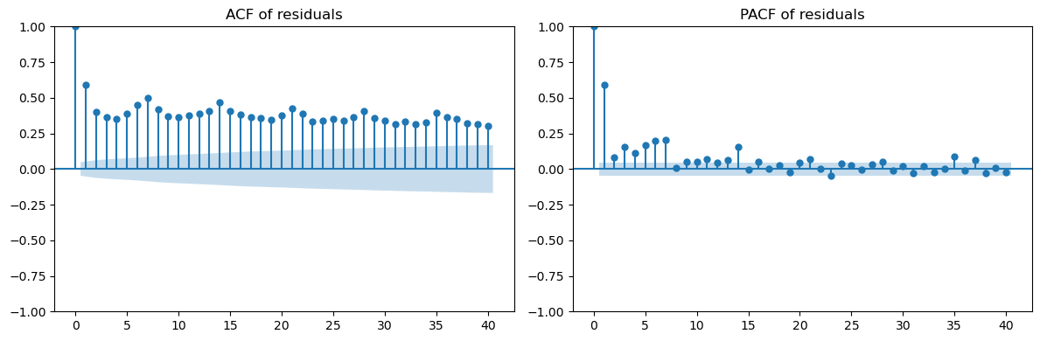
3. Decomposition, with residual autocorrelation
Fitted OLS regression to decompose seasonality with 90 dummy variables for day of week, day of month, week of year, and New Year’s Day
All but one coefficient statistically significant
Adj. R-squared of 0.84
VIF test indicated no multicollinearity

Slide 13
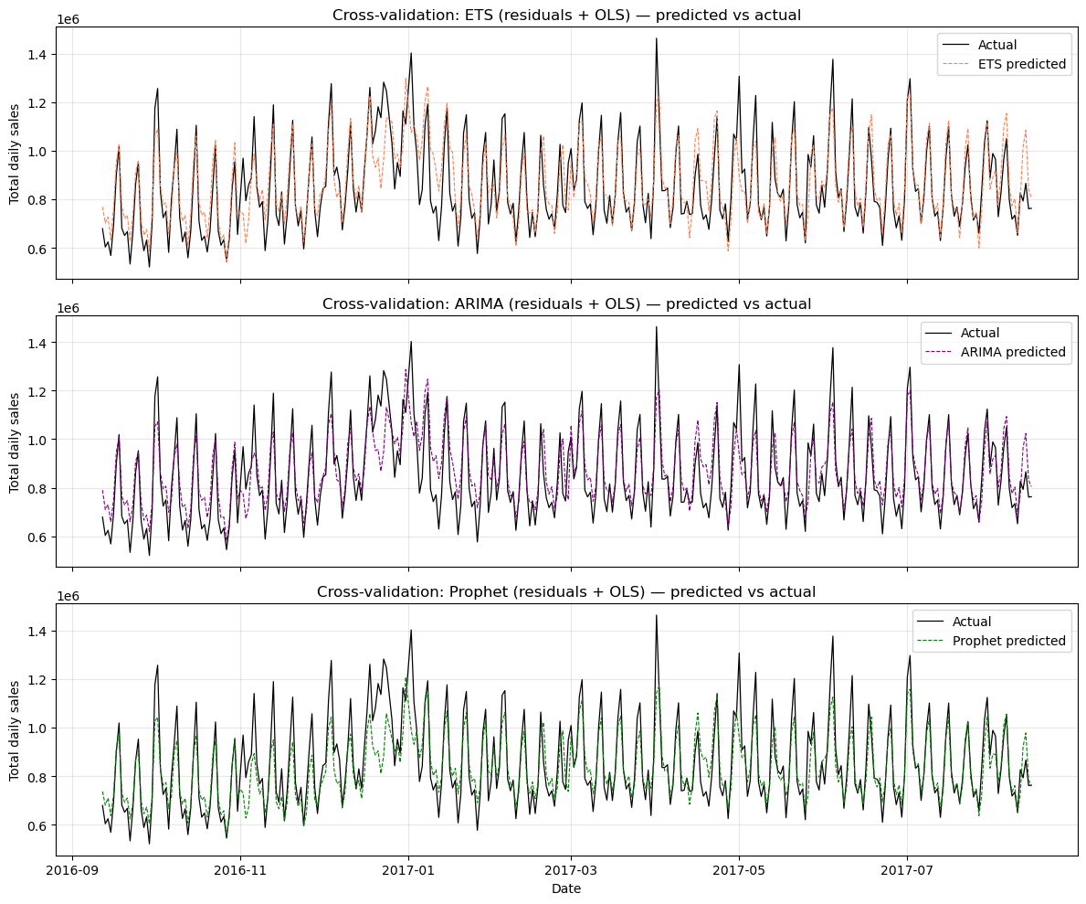
4. Fitting of time-series forecast models on residuals using 15-day expanding window cross-validation using 80/20 train-test split
MAE | RMSE | MAPE
65032 | 89516 | 7.6%
69302 | 90580 | 8.3%
64271 | 91426 | 7.2%
ETS
ARIMA
Prophet

Slide 14
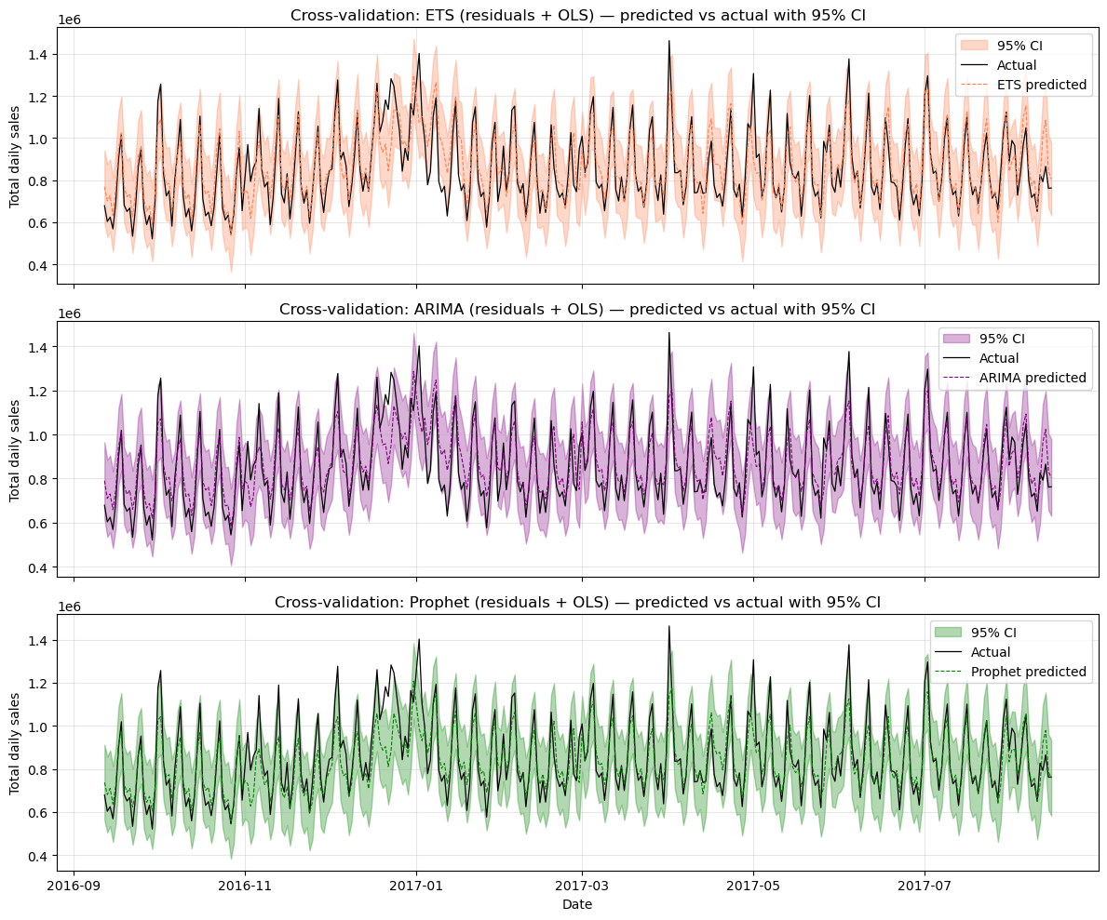
4. … with confidence intervals
ETS
ARIMA
Prophet

Slide 15
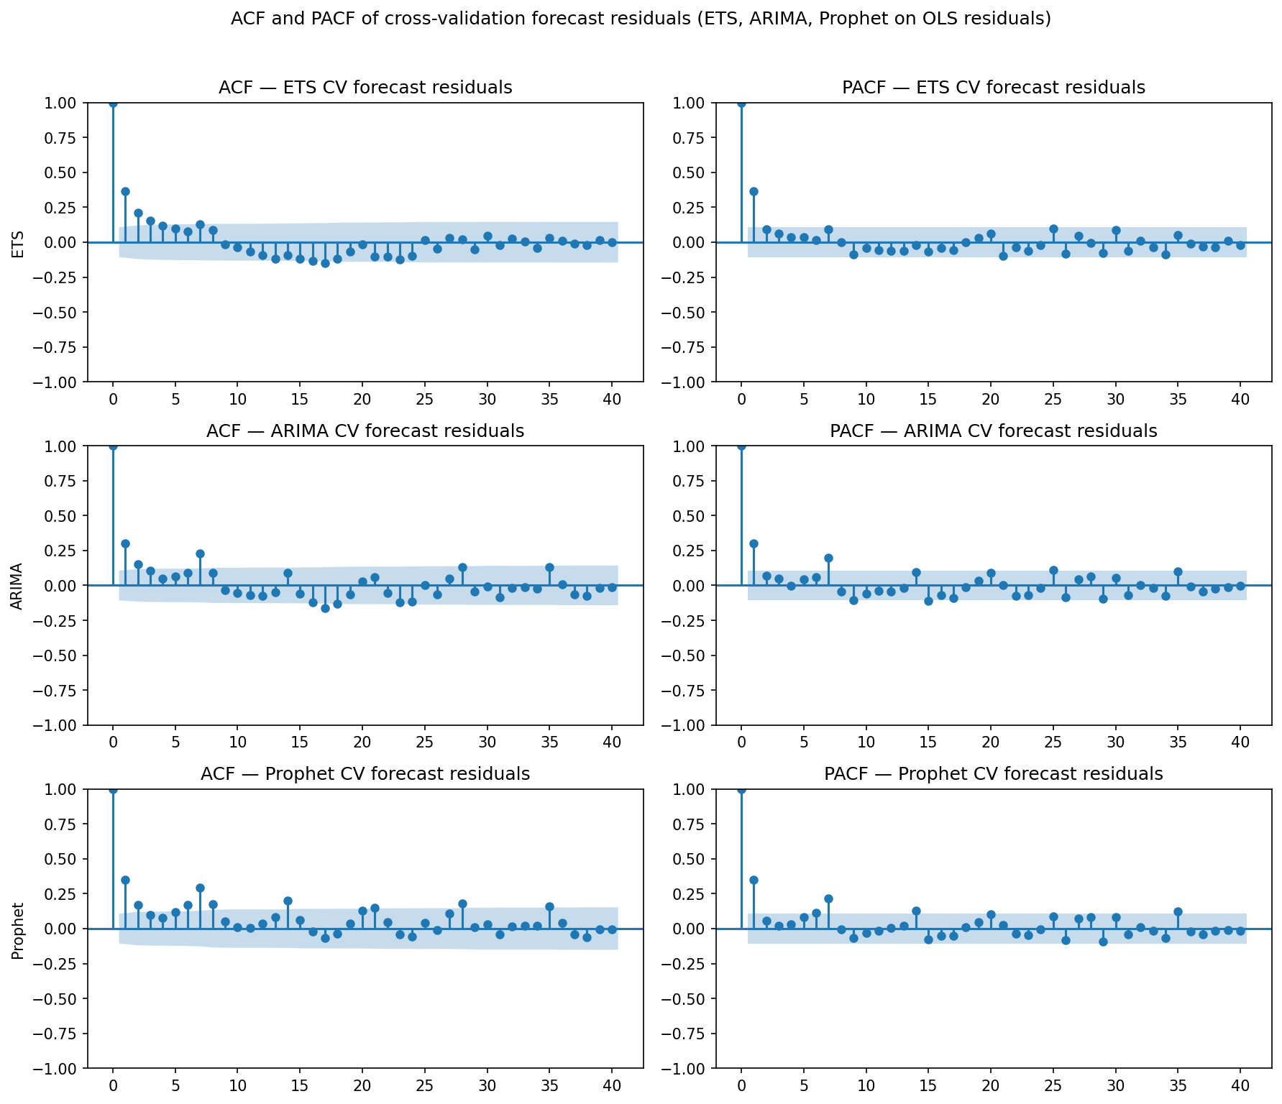
5. PACF reveal some seasonality still in the residuals at day 7 and 14 for ARIMA and Prophet

Slide 16
Conclusions
Data assessment and repair matters more than model selection
Somewhat similar performance across model types
Decomposition by OLS Regression followed by forecasting of residuals worked better – and OLS + Prophet best of all
For models of OLS + forecast of residuals, subsequent regressing of residuals ~ holidays and ~onpromotions were significant. There is additional information as yet not captured in the models (What is best course of action to include these?)

